Slide 1
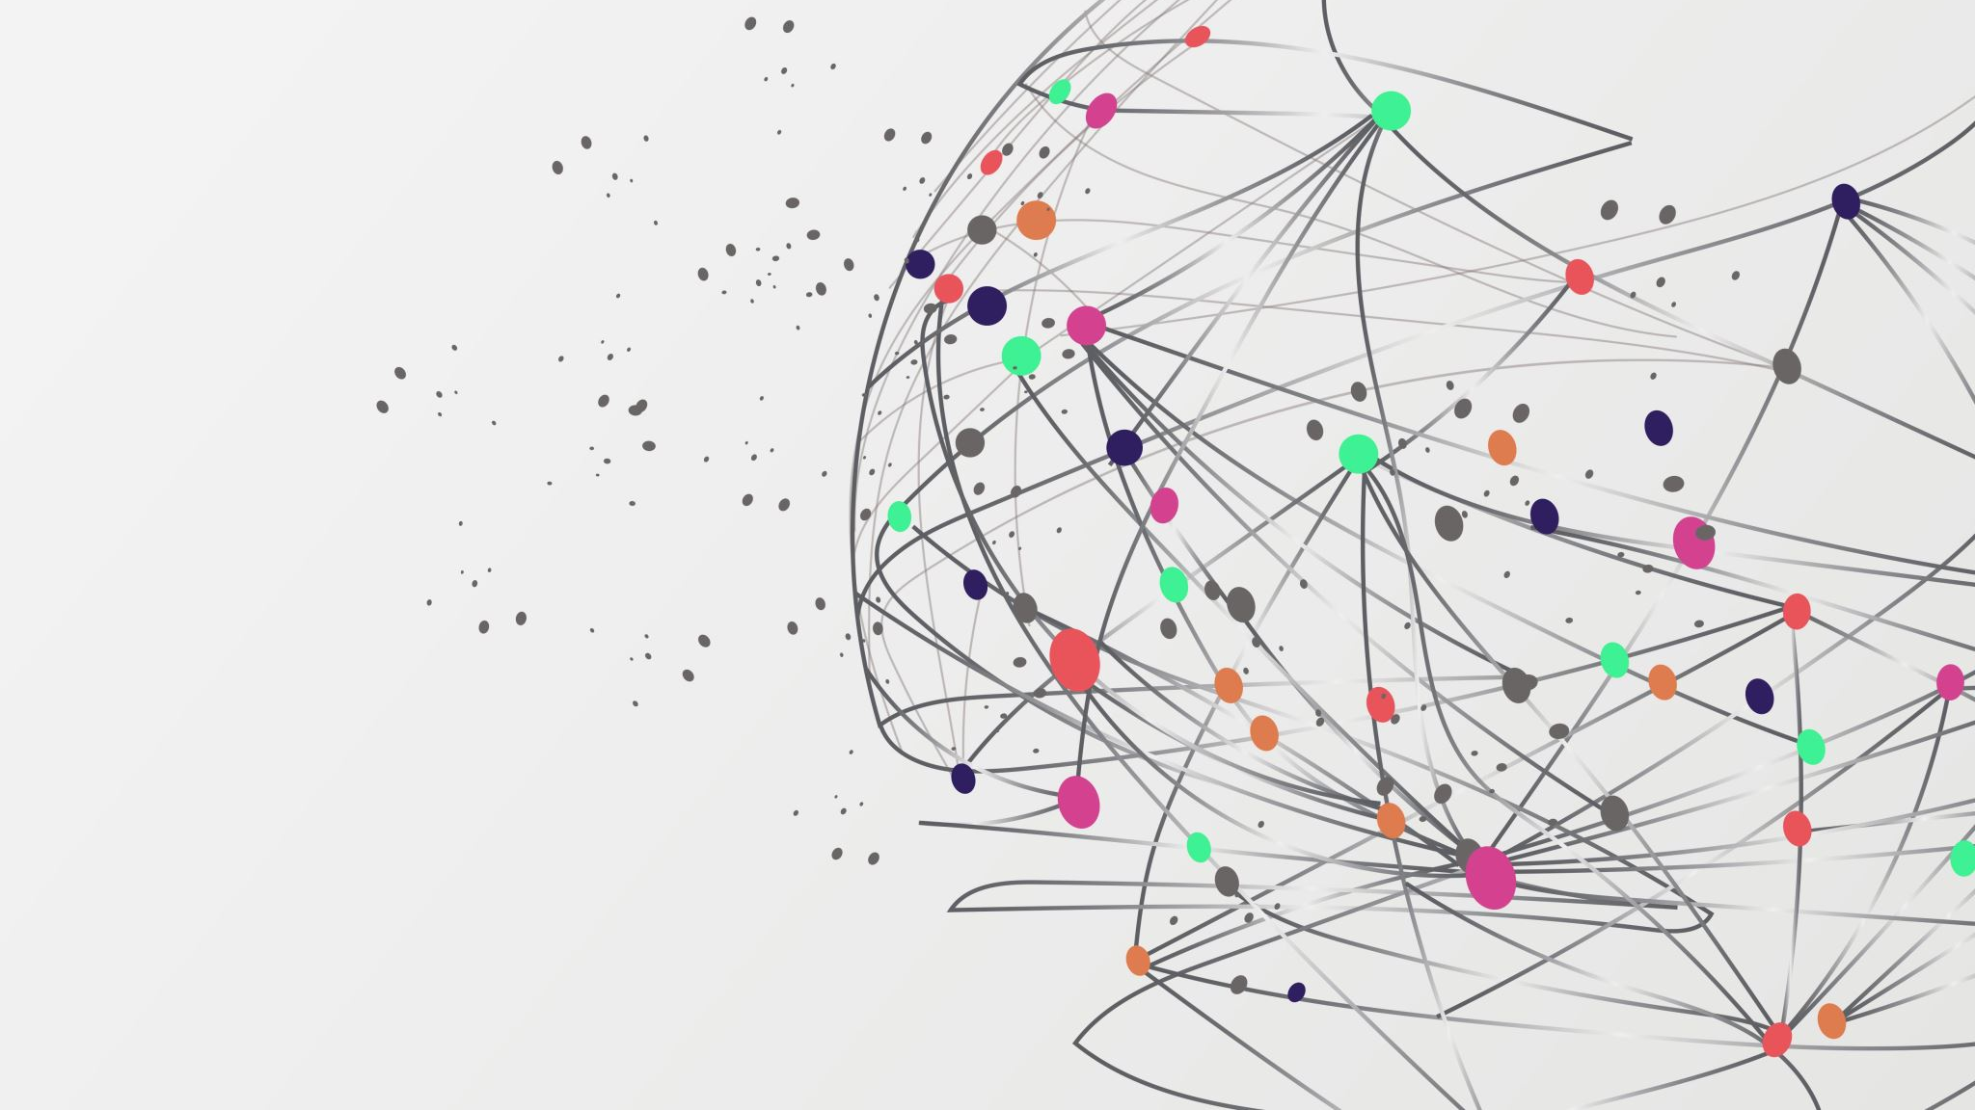
DATA MINING AND MACHINE LEARNING
Group members:
Abhishek Tiwari 21172277
Anuradha Nayak 21194106
Bharadwaj Ravur 21194521
Dinesh Gupta 21189048

Slide 2
Introduction
Methodology
Results
Conclusion

Slide 3
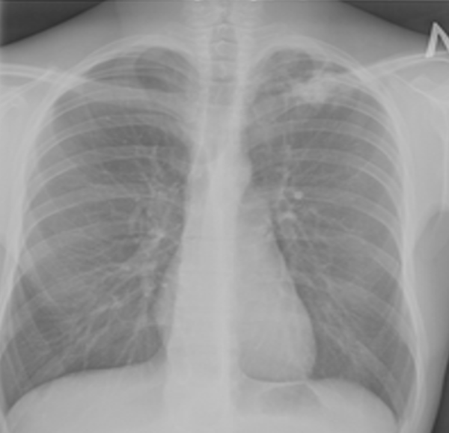
INTRODUCTION TO DATASET
The dataset contains CXR images of Normal (3500) and patients with TB (700 TB images in publicly accessible and 2800 TB images can be downloaded from NIAID TB portal by signing an agreement).

Slide 4
METHODOLOGY
PRE-PROCESSING
SPLITTING
APPLYING TECHNIQUES
OUTPUT
ANALYSYS/MODEL ACCURACY

Slide 5
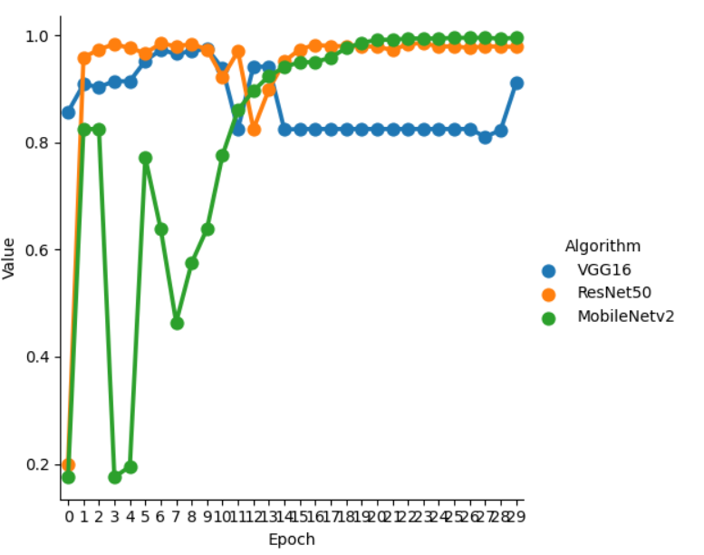
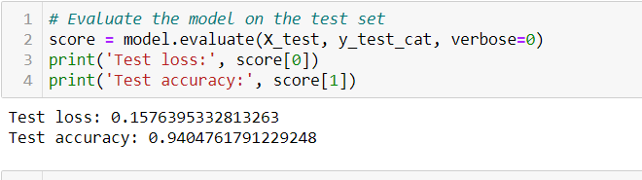
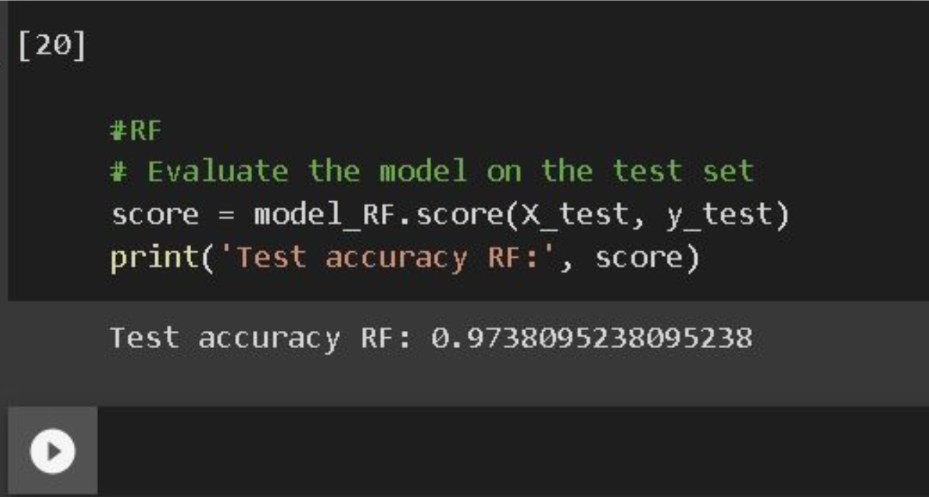
RESULTS
DEEP LEARNING
REGRESSION

Slide 6
CONCLUSION
Deep learning can improve TB diagnosis accuracy and efficiency using chest radiography.
The study used CRISP-DM to develop a deep learning model that classified chest radiographs into normal and TB categories accurately.
Various deep learning models such as VGG-16, ResNet-50, Inception-v3, DenseNet-121, Random Forest classifier, and support vector machine-based approaches have proven effective for TB diagnosis using chest X-ray images.
Future research can use these findings to develop more accurate, efficient, and cost-effective methods for TB detection, improving early diagnosis and patient outcomes, and having significant impacts on global public health.

